Slide 1
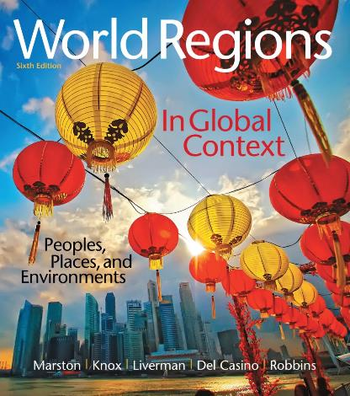
World Regions in Global Context:
Peoples, Places, and Environments
6th Edition
Middle East and
North Africa
Lectures by:
Christa Ann Smith

Slide 2
Learning Outcomes
Describe the diversity of physical geographic environments in the Middle East and North Africa.
Evaluate the importance of key resources, such as oil
and water.
Summarize the diffusion of cultural and environmental practices, such as religion and agriculture, throughout the region.
Explain the natural and historical factors that contribute to the diverse economies of the Middle East and North Africa, how they vary from country to country, and how they are tied to global and regional processes.

Slide 3
Learning Outcomes
Analyze the geopolitical conflicts and tensions that bring instability to the Middle East and North Africa and the relationship between these conflicts and the political history of the region.
Identify the differences in practices of kinship, gender, and religion in the region and how these factors affect the lives of women.
Describe the patterns of migration in the Middle East and North Africa, the push and pull factors that are involved in migration patterns, and the effects these patterns have on the region’s demography.

Slide 4
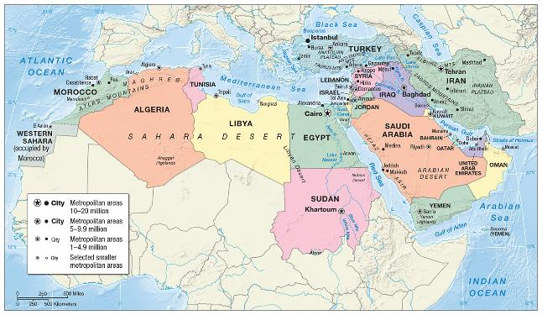
Environment, Society, and Sustainability
Environmentally diverse
Home of some of the earliest agricultural societies in the world
Historically significant rivers

Slide 5
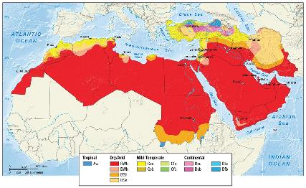
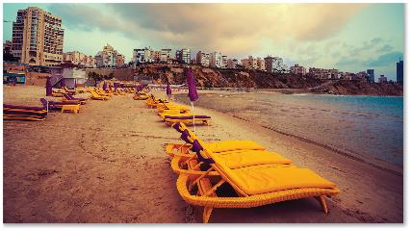
Climate and Climate Change
Dominant climate characteristic is aridity
  three-quarters of the region receive less than 10 inches of rain annually
Highland and coastal areas more moderate
  thin, deficient soils
Mountains
  orographic rainfall
  rain shadow

Slide 6
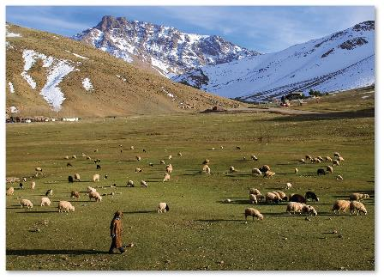
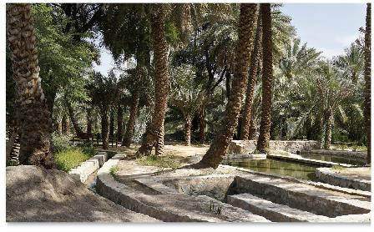
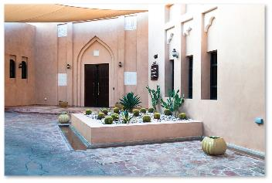
Climate and Climate Change (cont.)
Climatic adaptation
  regional architecture
  activity patterns
  dress
Climate change
  Kyoto Protocol
  carbon market

Slide 7
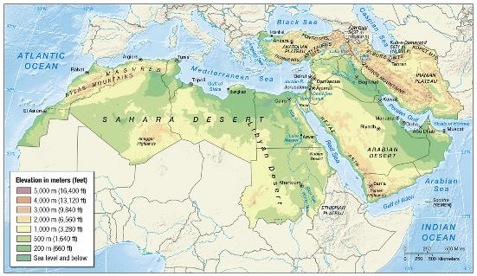
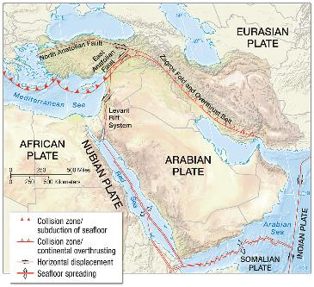
Geological Resources, Risk, and Water
Region home to multiple mountain ranges, two major river systems

Slide 8
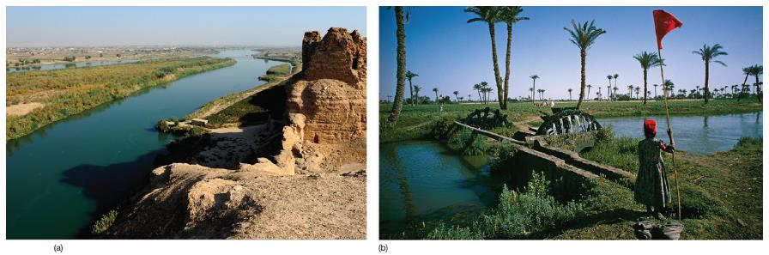
Geological Resources, Risk, and Water (cont.)
Mountain and coastal environments
  African, Eurasian, and Arabian plates
  earthquake hazard
  Turkey, Iran, Yemen, Morocco

Slide 9
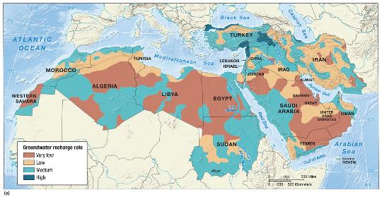
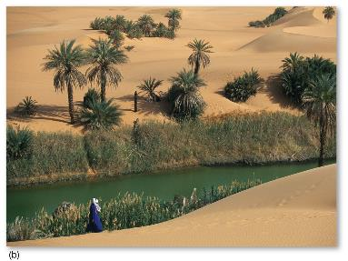
Geological Resources, Risk, and Water (cont.)
Regions most precious commodity: water
  Nile, Tigris, and Euphrates Rivers
  Oases
  gravity system
    Qanat, flaj, foggara
  desalinization

Slide 10
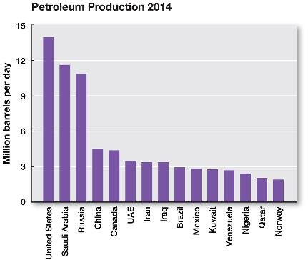
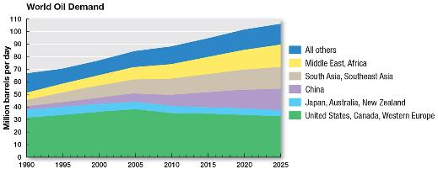
Geological Resources, Risk, and Water (cont.)
Fossil Fuels
  oil and natural gas
  petroleum
  invention of internal combustion engine and
  WW I established petroleum as a foundational product of industrial age
  early areas: Iran, 1900; Iraq 1920s; Bahrain, Saudi Arabia, 1930s
Organization of Oil Exporting Countries (OPEC)
  oil crisis

Slide 11
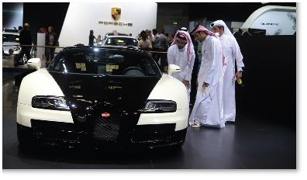
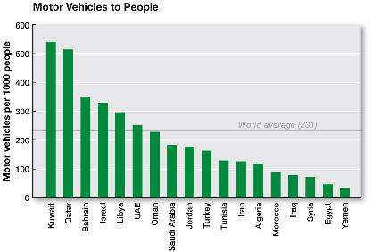
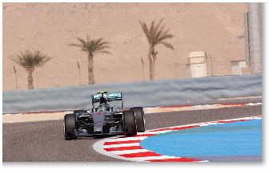
Geographies of Indulgence, Desire, and Addiction
Luxury cars, such as Bentley, saw rise in sales driven by high demand in Middle East
Dubai has highest ratio
of cars to people in the world
Region home to many
high-end Formula One races

Slide 12
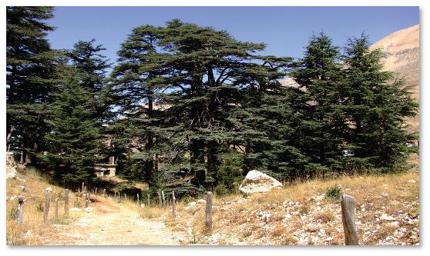
Ecology, Land, and Environmental Management
Deforestation in Turkey, Lebanon, Syria, and Iran
Extinctions
  leopards
  crocodiles
  oryx
  cheetahs
  lions
Desertification
Afforestation

Slide 13
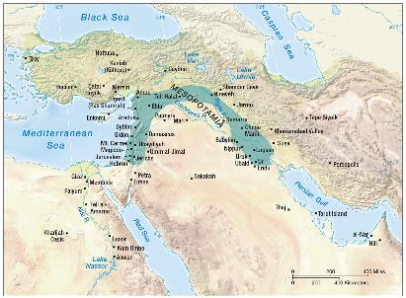
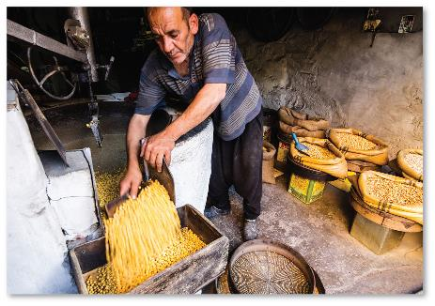
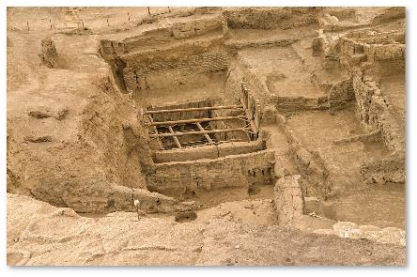
History, Economy, and Territory
Domestication of plants and animals
  10,000 to 12,000 years ago
  semi-permanent settlements

Slide 14
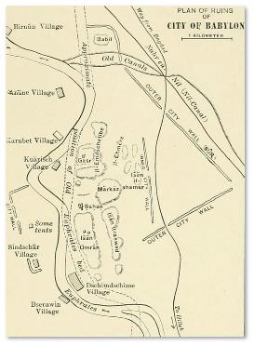
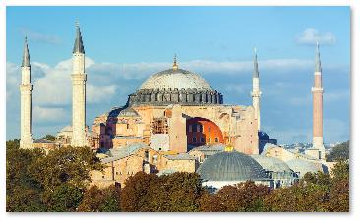
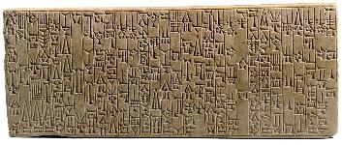
Historical Legacies and Landscapes
Fertile Crescent: early plant
and animal domestication
  wet farming
  hydraulic civilizations
Birthplace of world religions:
Judaism, Christianity, and Islam
Urbanization
  primary urbanization
  secondary urbanization
  Islamic
  cities

Slide 15
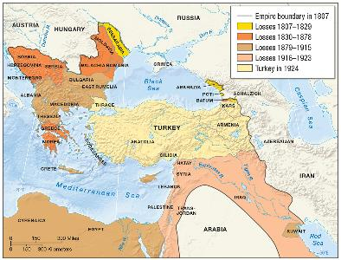
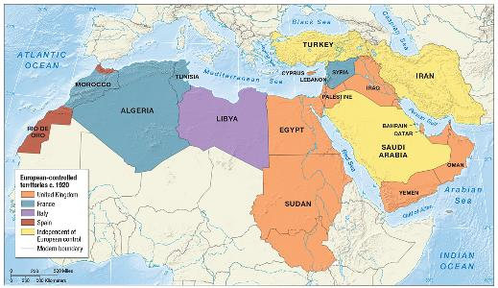
Historical Legacies and Landscapes (cont.)
Ottoman Empire
  nationalist movements
  mandates
“Middle East”: What’s in a name?

Slide 16
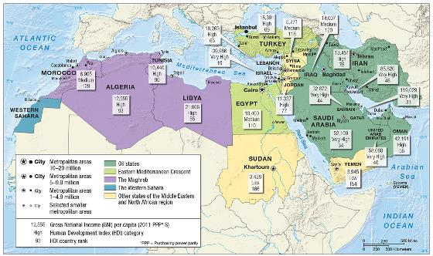
Economy, Accumulation, and the Production of Inequality
Import substitution
Nationalization
Rural-to-urban migration
  informal
  economy
Oil states
  oil dependence
  petrodollars
  economic
  diversification

Slide 17
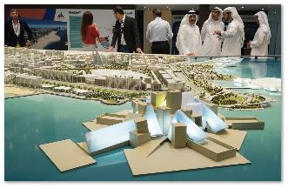
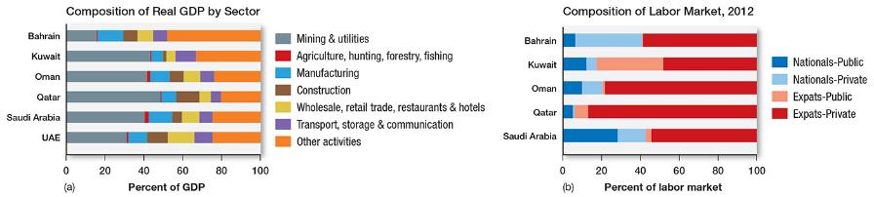
Economy, Accumulation, and the Production of Inequality (cont.)
Eastern Mediterranean Crescent
  Egypt, Lebanon, Israel, Turkey
The Maghreb
  Morocco, Algeria, Tunisia, Libya
  Union for the Mediterranean
Social inequalities

Slide 18
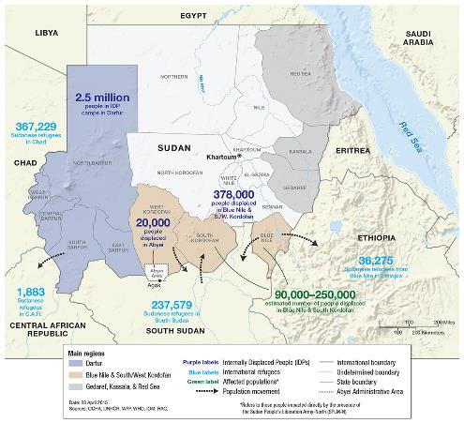
Territory and Politics
Intra-regional conflict
Ethnic conflict
  Iran (Persians) and Iraq (Arabs)
  Kurds
  Sudan
  Janjaweed
  internally displaced persons

Slide 19
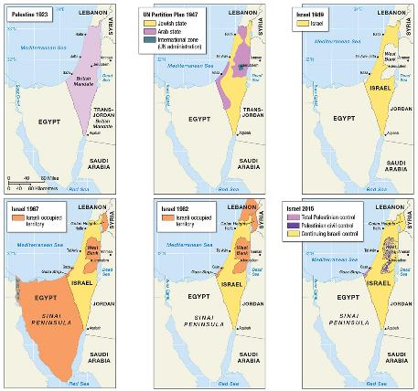
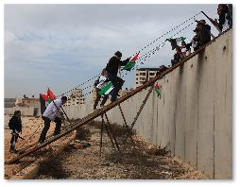
Territory and Politics (cont.)
U.S. war in Iraq
  Saddam Hussein
  weapons of mass
  destruction (WMD)
  jihadists
Nuclear tensions
Rise of ISIS
Regional alliances
  Arab League
  Gulf Cooperation Council

Slide 20
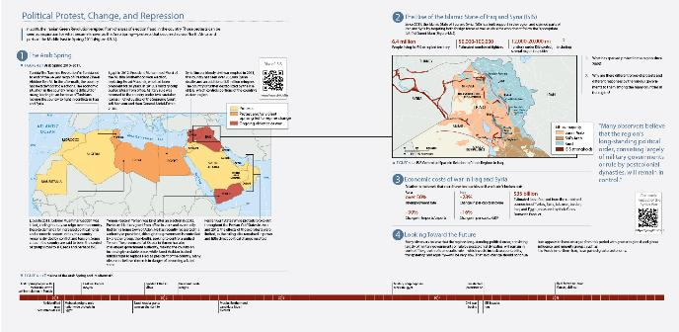
Political Protest, Change, and Repression
Arab Spring
  Syria
  role of social media
  democratic and economic reform
  rise of ISIS

Slide 21
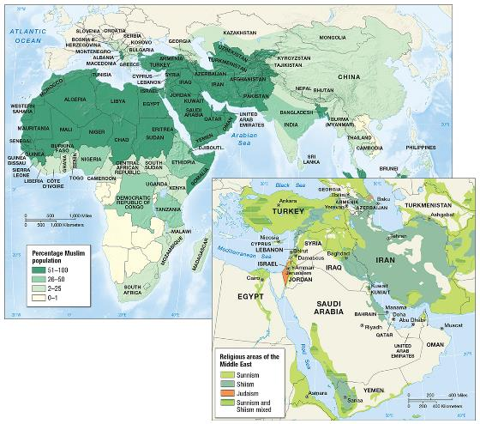
Culture and Populations
Culturally and demographically diverse region
  secularism

Slide 22
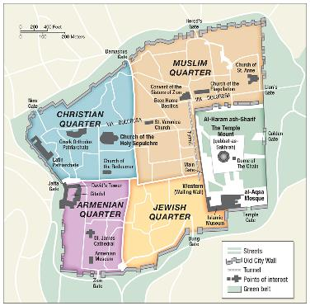
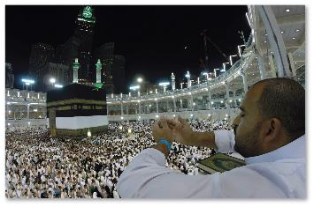
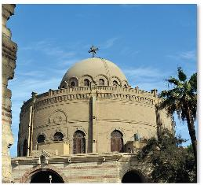
Religion and Language
Religion
  Islam
    Qur’an
    Islamism
    Jihad
  Christianity
  Judaism

Slide 23
Religion and Language (cont.)
Three major language families
  Semitic
  Indo-European
  Turkic

Slide 24
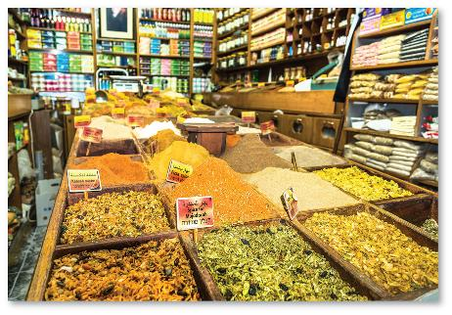

Cultural Practices, Social Differences, and Identity
Cultural practice
  food
    meze dishes
  the arts

Slide 25
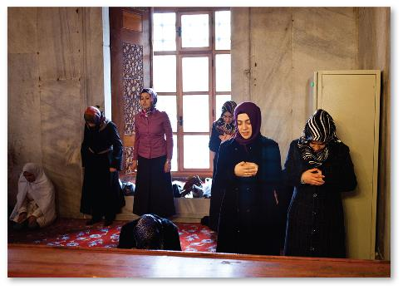
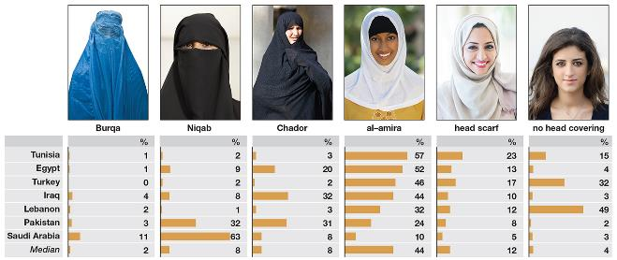
Cultural Practices, Social Differences, and Identity (cont.)
Kinship
  tribe
  transhumance
Gender
  stereotypes
  chador
  national politics
  sexuality

Slide 26
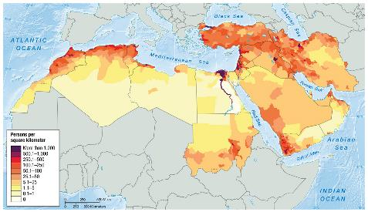
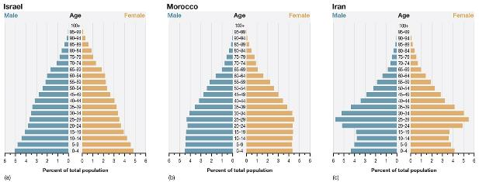
Demography and Urbanization
Pull factors
  guest workers
  immigration policies
Push factors
  civil unrest
  lack of economic opportunities
Cities
  rapid growth
  housing and
  service needs
  not met

Slide 27
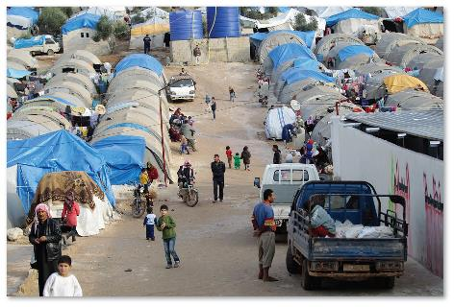
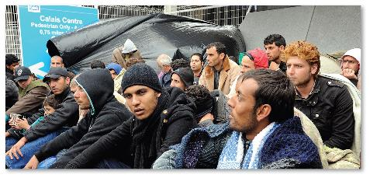
Faces of the Region
Syrian War refugee crisis
  1.6 million children displaced by the war
  many have fled into neighboring Turkey

Slide 28
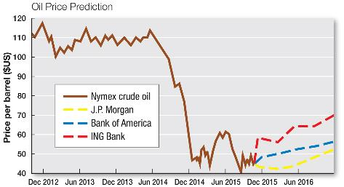
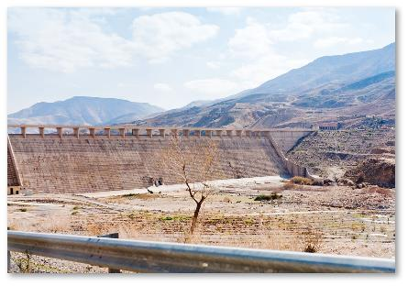
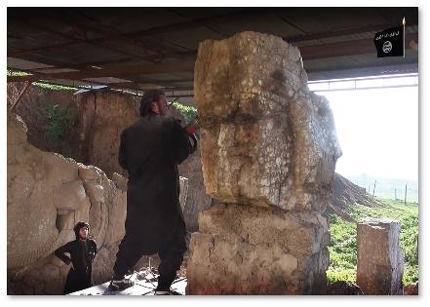
Future Geographies
Oil
  diminishing supplies
Water
  sustainability
Peace and stability

